Slide 1

Final Project – iNaturalist competition
唐甫頌 Kim-Benjamin (0845058)
林彦岑 (0856125)
許可 (0840033)

Slide 2
Today’s agenda
Introduction
Related Work
Proposed Approach
Experiment Results
Conclusions

Slide 3
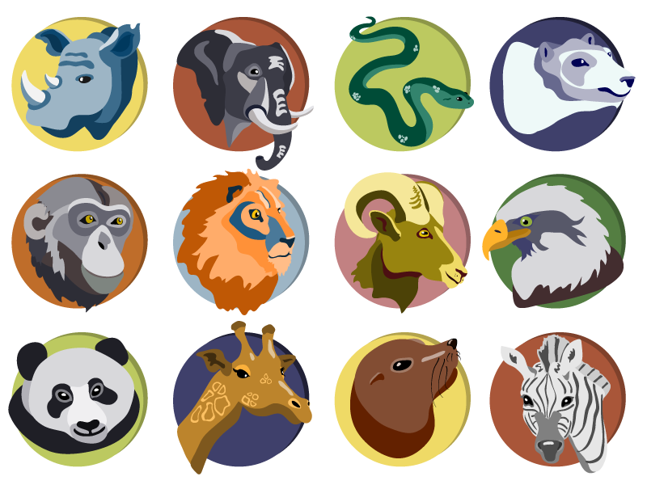
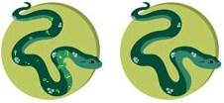
Introduction
Motivation:
Problem
Several million species of plants and animals
Difficult to classify with no expert knowledge due to similarities
Solution
Competition to push technologies for automatic classification with large number of fine-grained categories

Slide 4
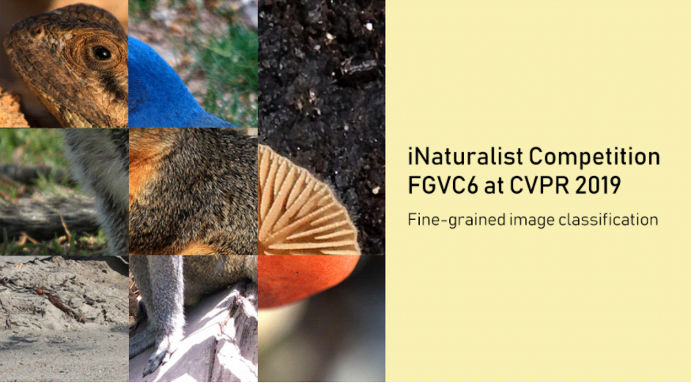
Introduction
iNaturalist Competition:
Fine-grained multi-class species classification with images
Very similar categories
1010 different species

Slide 5
Introduction
Goal of competition:
High accuracy within a limited time period
Evaluation metric: top-1 classification error
If label for image matches – error: 0
If label does not match – error: 1
Final score averaged over all instances
Dataset in total contains 268,243 images

Slide 6
Introduction
Challenges:
Storage issues:
Over 85gb in .zip format was too much for Kaggle / Google Colab
Memory issues:
Own computer had insufficient memory, e.g. 4GB ram
As a solution the computation was executed in the lab

Slide 7
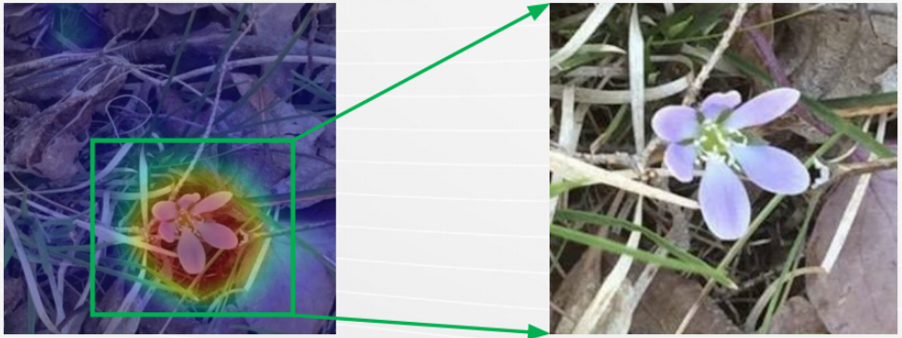
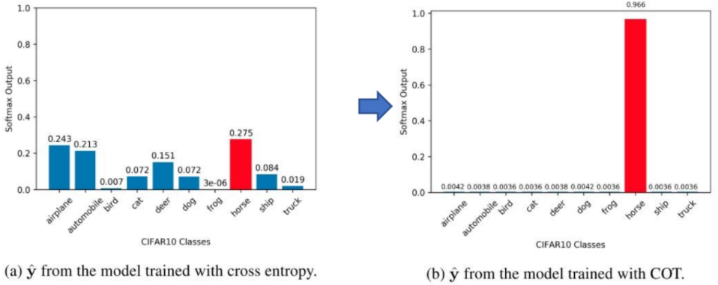
Related Work
Approaches by strong competitors (top 5/214):
Weakly supervised localization with CAM (Class Activation Map)
Improve accuracy by small object localization
Complement entropy loss
Maximize likelihood of ground truth while neutralizing probabilities of complement classes
1.
2.

Slide 8
Related Work
Approaches by strong competitors (top 5/214):
Class balanced sampling (less bias from unbalanced data)
High resolution input (560*560)
Model ensembling (4 models)
ResNet-50

Slide 9
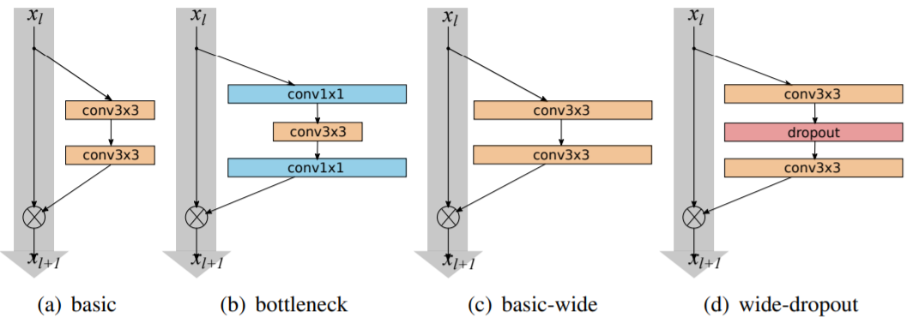
Proposed Approach
GitHub Link
Model: Wide ResNet

Slide 10
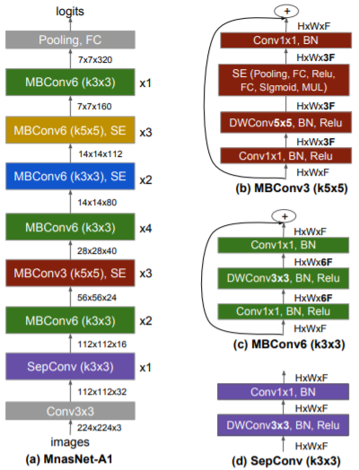
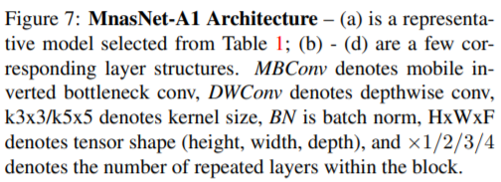
Proposed Approach
Model: MnasNet

Slide 11
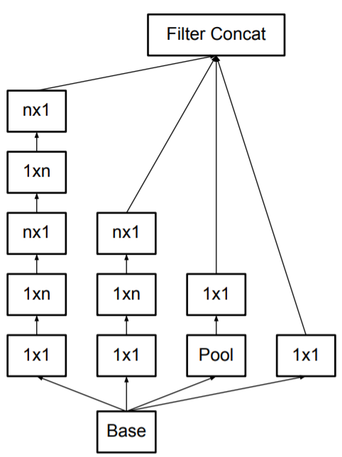

Proposed Approach
Model: Inception-v3

Slide 12
Proposed Approach
Data processing:
Load the data (images with annotations)
Augment the data:
Uniform size of 299x299 resolution
For color: brightness, contrast, saturation, hue modifications
For image: Scaling, flipping, center crop
Training:
Tune hyperparameters, epochs and batch sizes

Slide 13
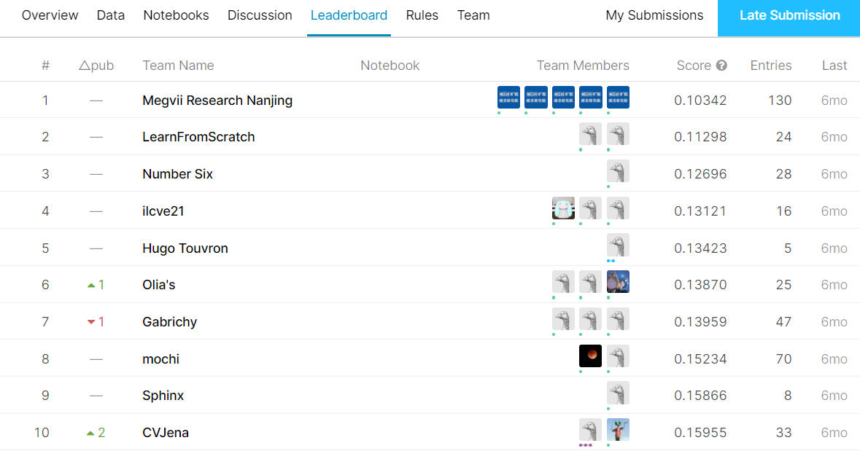
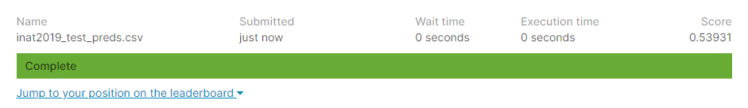
Experiment Results
Low performance compared to the best of the competition
Would score at #147 out of 214 (+ us) on competition leaderboard (Top 68 %)
Competition leaderboard
Our best submission

Slide 14
Conclusions
Data augmentation helped to improve the performance
Very difficult task
Difficult to achieve a high performance
Much more time required for better training and hyperparameter fine tuning

Slide 15
Thank You for Your Attention!

Slide 16
References
Images:
Animals: https://briefbox.me/wp-content/uploads/2017/04/animal-icons.png
Inception v3: https://cloud.google.com/tpu/docs/inception-v3-advanced
Related work images: https://drive.google.com/file/d/1T8XABp6ayFTRpwbEYPFYICfIRXrD1fJB/view
Related work: https://www.kaggle.com/c/inaturalist-2019-fgvc6/discussion
https://drive.google.com/file/d/1T8XABp6ayFTRpwbEYPFYICfIRXrD1fJB/view
Code: https://www.kaggle.com/c/inaturalist-2019-fgvc6/notebooks

